Slide 1
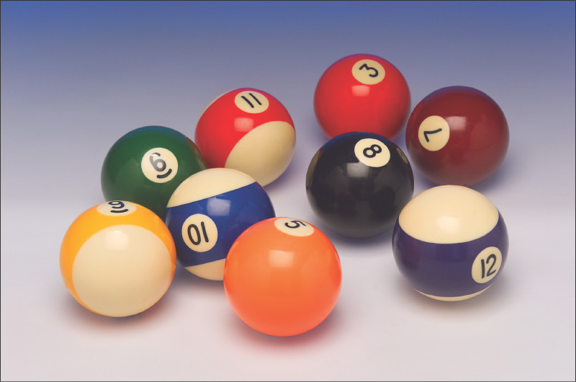
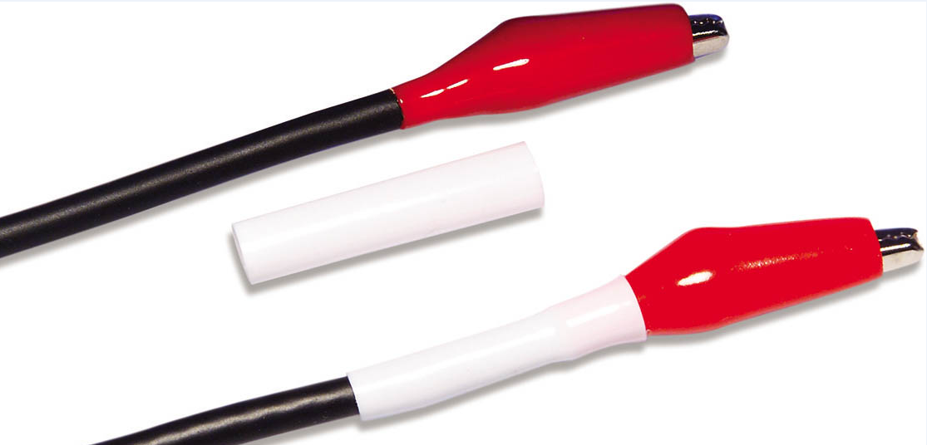
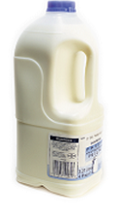

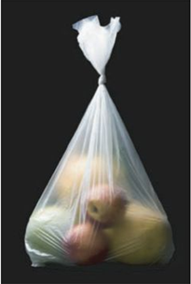
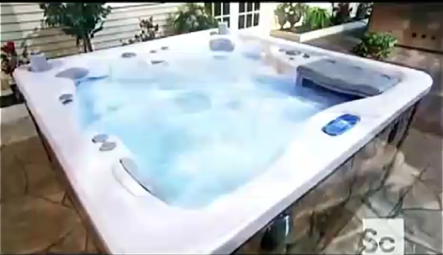
Polymers – Chap 14-15
Notes:
LDPE – low density polyethylene
Thermoplastic vs Thermoset
Video online for the making of spa tubs

Slide 2
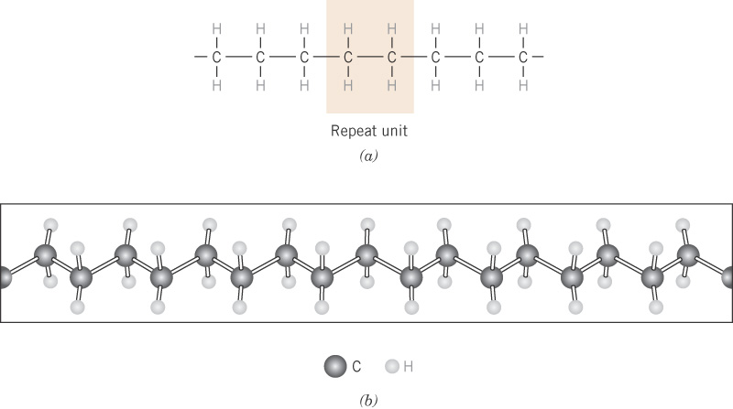
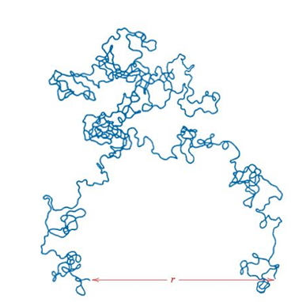
c04f01
Example: Polyethylene (PE)
mer
28 g/mol
109°
Covalent
Notes:
Monomer is not the same as a “mer”. Monomer is one mer which is actually the molecule used to produce the polymer in this case ethylene.
We sketch the structure linear as in the first image for simplicity but even as linear it would look more like the second image. In reality, although the bond angles are fixed, they do allow for rotation so instead of linear the polymer chain for kinks and coils and would look like the third image.

Slide 3
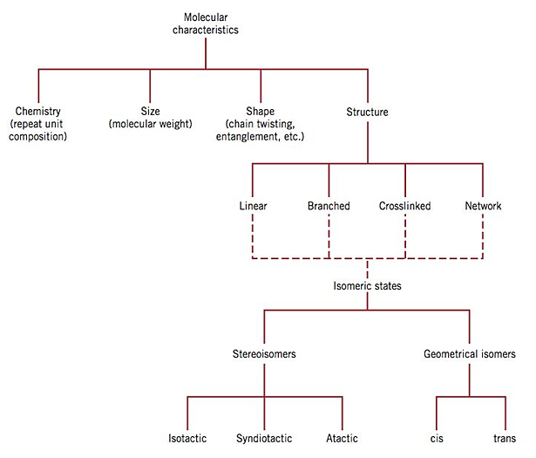
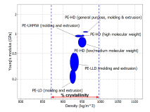

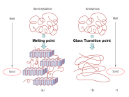
Such a simple structure at first glance but this leads to many variations all of which drastically change the polymeric properties.

Slide 4
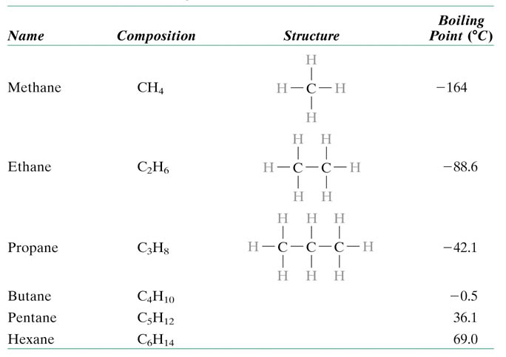

MW
(g/mol)
16
30
44
72
liquids
86
paraffin wax
T_{melt} ~ 37 C
Notes:
Hexane = 12*6+1*14 = 86 g / mol
Paraffin wax = 12*20+1*42 = 282 g/mol up to 12*40+1*82 = 562 g/mol
MW: g per mole of chains e.g. 10,000 repeat units * 28 g / mole of repeat units for PE = 280,000 g / mole up to > 1,000,000 g/mol for UHMWPE

Slide 5

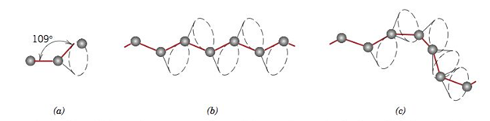
Notes:
Although 109 is fixed we can rotate about this angle to change configuration of chain. Chain can rotate, bend, etc. End to end distance is no longer chain length. This configuration also allows for chains to intertwine.

Slide 6
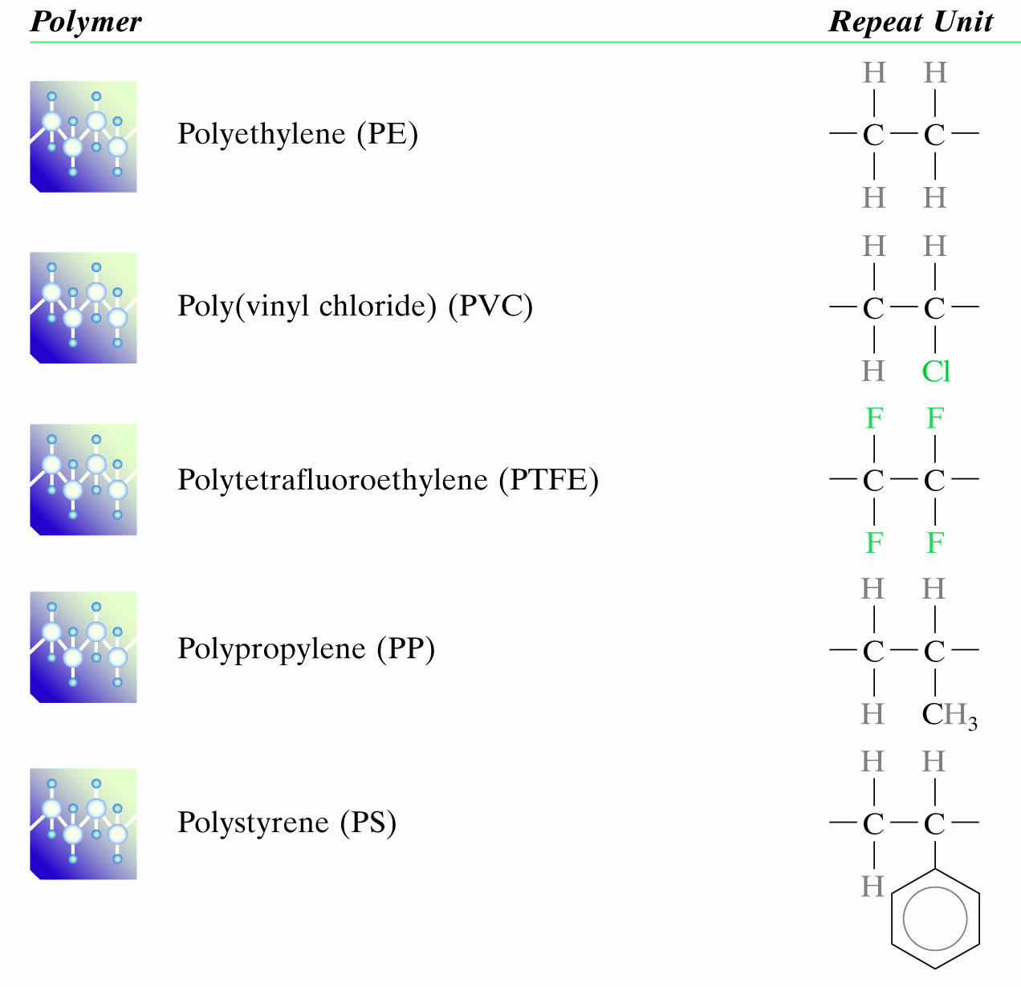
1000’s to 10,000’s
Notes:
mer units: 1000 to 10,000 or more (UHMW 100,000 – 250,000)
MW: 10,000s to millions

Slide 7

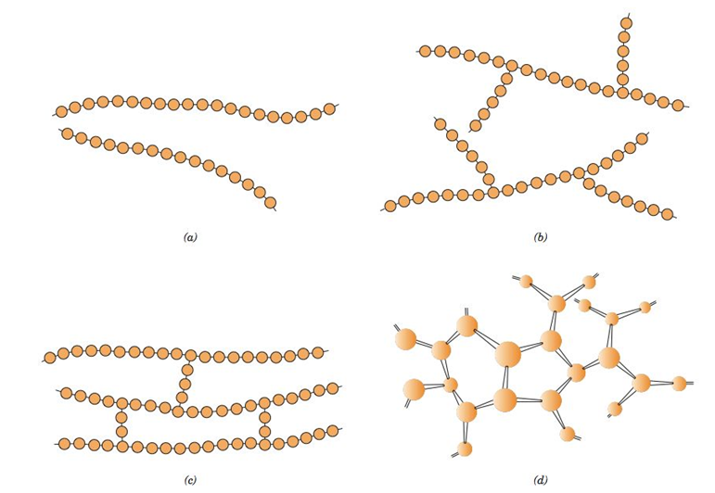
Notes:
Linear, branched, cross-linked, network
Branching reduces density – e.g. LDPE vs HDPE

Slide 8
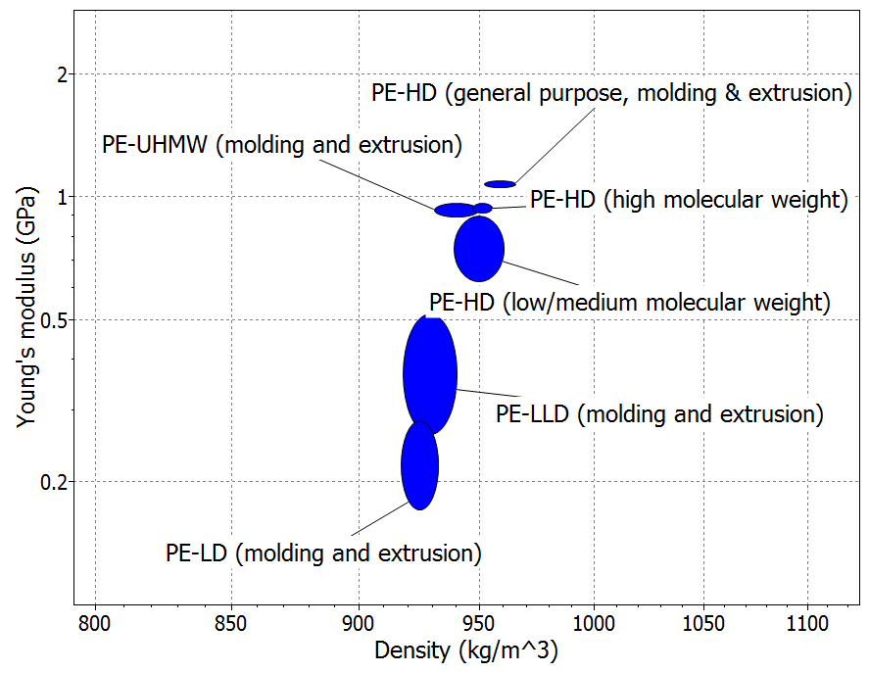
% crystallinity
Notes:
LDPE – branching, density = 910 – 940 kg/m3
HDPE – essentially no branching, density = 930 – 970 kg/m3
LLDPE – linear low density, long chains short branches -- high strength and toughness, large elongation compared to LDPE
LDPE – larger spread in chain length, long side branches
HDPE – very little branching, higher degree of crystallinity than LDPE
LLDPE – 50,000 – 500,000 g/mol
UHMW – ultra high molecular weight – > 1,000,000 g/mol
UHMW can have 100,000 to 250,000 mer units (vs. 1000 mer units for other PE)
Cross linked PE – PEX used in piping (thermoset)

Slide 9
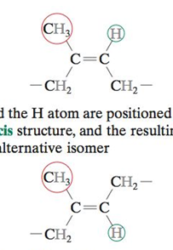
Cis-
Trans-
Notes:
Geometric: when you have a double bond
Cis: side group and H on same side of double bond
Trans: side group and H on opposite sides of double bond
Natural rubber is Cis isoprene – stays amorphous
Gutta Percha is Trans isoprene – crystallizes – hard and brittle

Slide 10


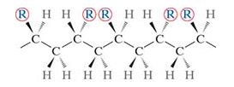

Example:
Notes:
Isotactic – same side of chain; Syndiotactic – alternate sides of chain (in and out of board); atactic – random

Slide 11
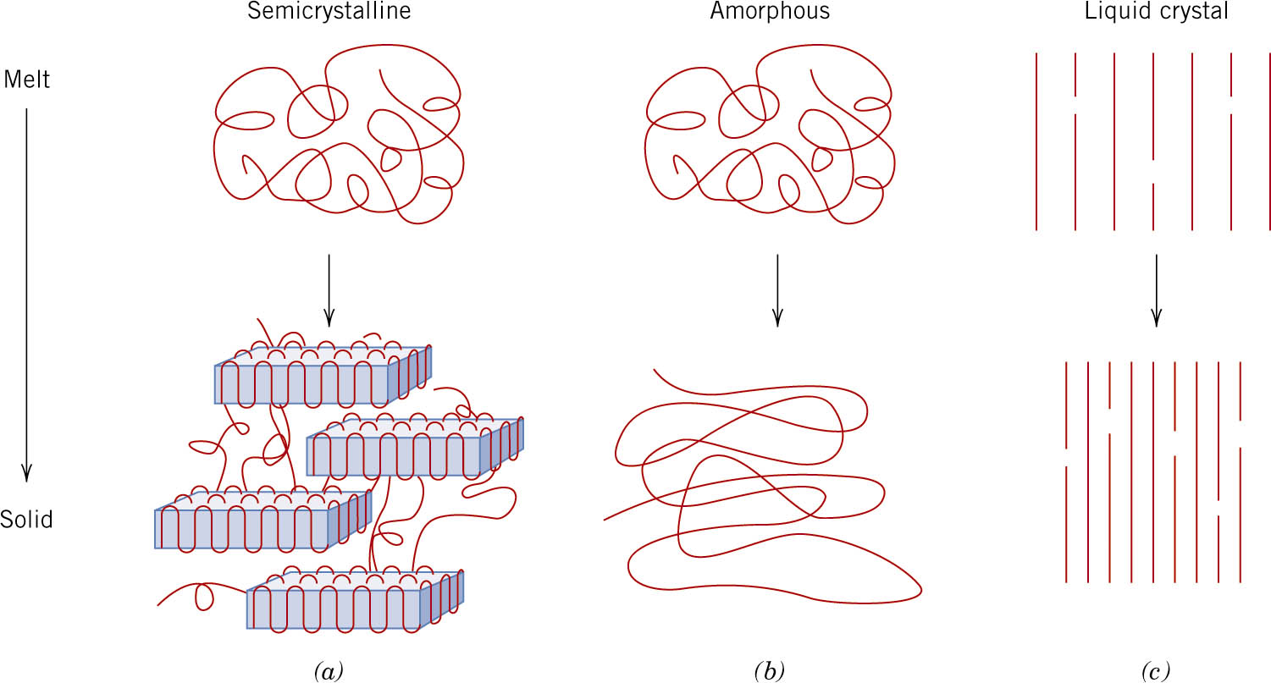
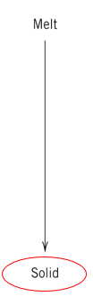
Melting point
Glass Transition point

Slide 12
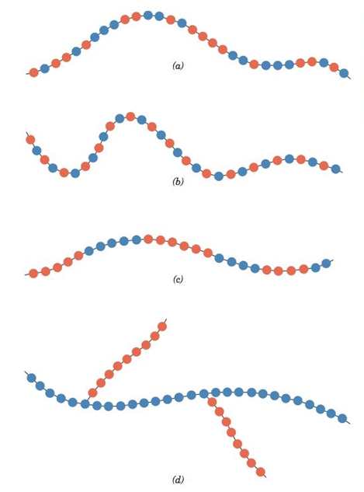

Random
Which in which?
Alternating
Alternating
Block
Graft
Random
Block
Graft
Notes:
Random, Alternating, Block, Graft

